Slide 1




Developing Questions and Designing the Questionaire

Slide 2

Agenda
Case 5 Discussion
Level of Measurement

Slide 3
What is coming up – busy two weeks
PA#4 Questionnaire design Due soon; signup sheet for peer team review and professor one-on-one review
Level of measurement quiz (individual)
Qualtrics homework (individual)

Slide 4
Steps to design questionnaire
Preparation:
Determine what information is needed (PA3)
Determine the method of administration
Write the questions:
Determine content of individual questions. (what kind of question)
Determine the form of response for each question (multiple choice, rating scale, etc.)
Determine the wording of each question and response
Organize the questionnaire:
Determine the sequence and number the questions
Appearance
Develop a recruiting message. Background of the survey, Does it attract respondents?
Evaluate
Evaluate the questions with respect to the research questions:
Qualifying - better respondent, Classifying, Answer RQ.
Add RQ. & enough to answer RQ?
Pretest : ask a few friends to answer the questionnaire and provide feedback such as the confusing question wordings and inappropriate response options.

Slide 5
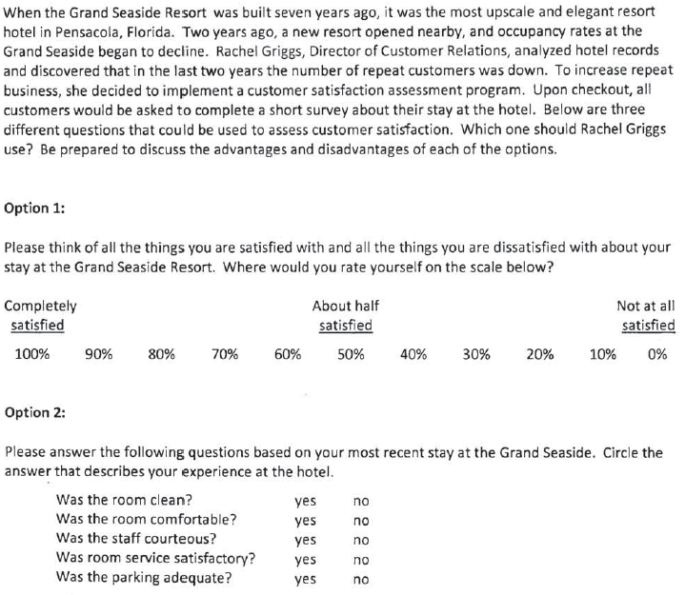
CE5

Slide 6
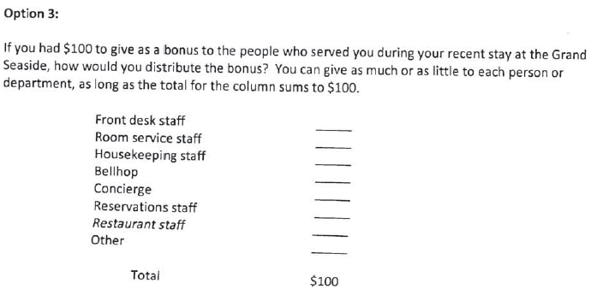
Option 3

Slide 7
Questions from other teams
Team 1 and 3: Which one of these surveys do you think would have the highest response rate if they were optional? Do you personally prefer to write down how their service was or circle/mark a scale from completely satisfied to unsatisfied?
Team 2: From option 2, how would be able to get specific research if people were in between on “Yes” or “No”?
Team 7: Which option would be the best way to see customer satisfaction? Is there another way you would use to rate customer satisfaction?
Notes:
Team1:
1. Would it be effective for Rachel to use more than one of the survey questions?2. Which one of these surveys do you think would have the highest response rate if they were optional?
T2: Address it.
From option 2, how would be able to get specific research if people were in between on “Yes” or “No”? Would the results be skewed since they are only given two option instead of multiple options to answer the questions?
T3:
1. What form of survey would you consider more cost effective and produce the best results?2. Do you personally prefer to write down how their service was or circle/mark a scale from completely satisfied to unsatisfied?
T6:
1. For Option 2, are the questions too specific? How were these specific questions selected?2. For Option 3, could there be an option to explain why a high or low tip was given?
T7:
Why do you think the option you chose would be the best way to see customer satisfaction?Is there another way you would use to rate customer satisfaction?

Slide 8
Data Collection Method
Surveys
Understand two critical aspects of surveys
How to design the questionnaire
Questions
Reponses
Notes:
In today’s class we will focus on response formats

Slide 9
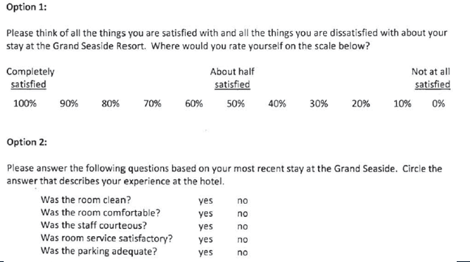
What is a Response Format
Response Format help you capture the response in the desired format

Slide 10
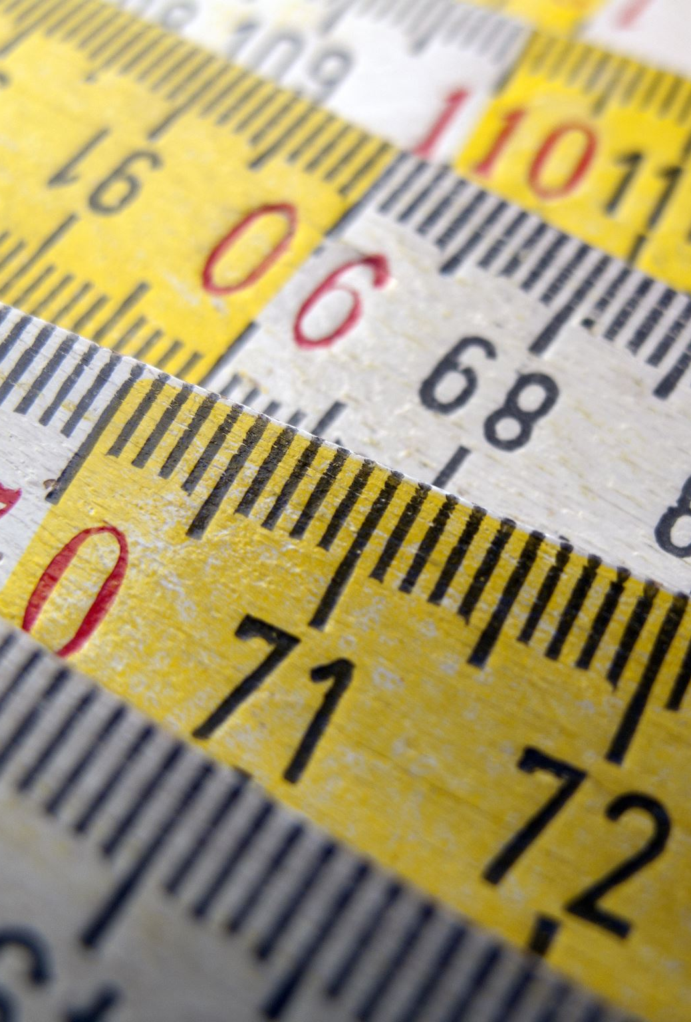
What is Measurement?
Measurement is determining how much of a property is possessed by the entity you are measuring. Entity in our case can be customer, brands, stores, advertisements etc.
Measurement vs. the variable?
Notes:
measurement is amount of information within a variable.
For example, gender. how much detail? to what extend you consider yourself as a female?

Slide 11
What is Property
Properties are specific features or characteristics of an object that can be used to distinguish it from another object
Objective properties are physically verifiable such as age, income, # of bottle purchased, store visited, weight
Subjective properties are unobservable/unseen or mental constructs such as person’s attitude, intention, etc.

Slide 12
Defining Scales for Measurement
To measure we need scales
Scales Characteristics
Description: the use of a descriptor, or label, to stand for each “unit” on the scale; “yes,”, “no,” “male,” “female,” “buyer,” “non-buyer,” etc.
Order: the relative sizes of the descriptors are known allowing us to say one is “greater than/less than/equal to” the other

Slide 13

Scales for Measurement
Scale Characteristics
Distance: the differences between the descriptors are known: there is a $1 difference between $4 and $5. there is a 10-degree difference between 90 and 100 degrees
Origin: there is a true, natural zero: there is a zero level of dollars, market share, sales (i.e., the 0 is not arbitrary)

Slide 14

Levels of Measurement Scales
Nominal scales: those that use only labels
Ordinal Scales: those with which the researcher can rank-order the respondents or responses
Interval scales: those in which the distance between each descriptor is equal
Ratio scales: ones in which a true zero exists. They can only be used for objective properties such as age, income.

Slide 15

Levels of Measurement Scales
Level of measurement
Description
Order
Distance
Origin
Example
Categorical Scale
Nominal
Which brands you use
Ordinal
Rank the brands from 1st to 5th
Metric Scale
Interval
Rate each brand on 1-7
Ratio
How many times do you use each brand?

Slide 16
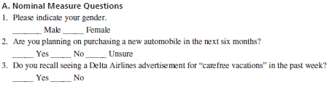
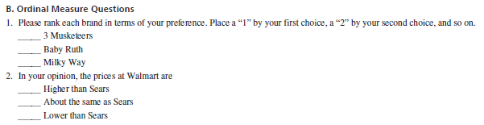
More examples on level of measurement
3. How often do you visit Walmart on average per month? Hint: the response options are not the same interval
__ 0 times __ 1-3 times __ 4-10 times __11+ times
Notes:
Ranking can be assigned or explicit among the option. It must be explicit in the response options.

Slide 17
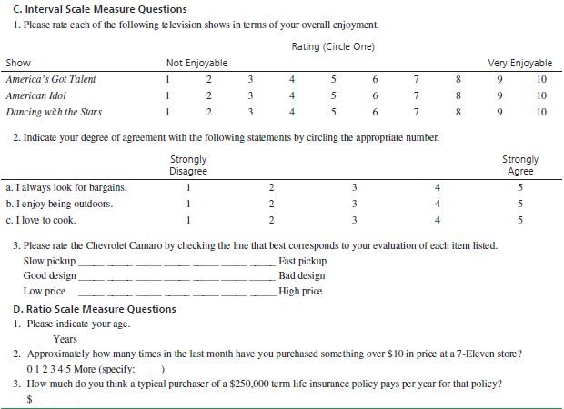
More examples
Notes:
_ _ _ can also represent the distance is equal

Slide 18
iClicker
Write down the level of measurement for each of the QQ responses:
A – nominal B- ordinal C- interval D- ratio
How often do you use the Ellis Library?
Less than once a week
About once a week
Twice a week or more
About how many hours per week do you use the library? _____Hours
How well does the library meets your needs?
Very well 1 2 3 4 5 Very badly
What is your major?
_____

Slide 19
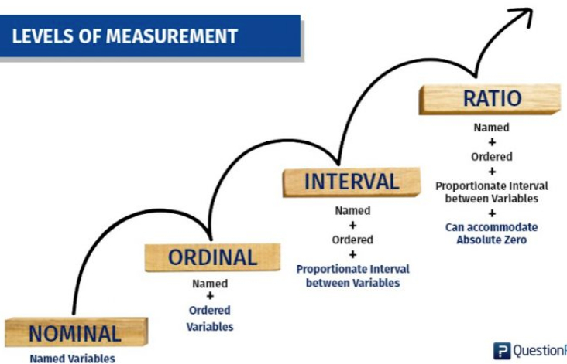
Statistical Procedure
Offers | Nominal | Ordinal | Interval | Ratio
Mode | Yes | Yes | Yes | Yes
Median | - | Yes | Yes | Yes
Mean | - | - | Yes | Yes
Absolute Zero | - | - | - | Yes

Slide 20
Why the Level of a Measurement Scale Important
The scale affects what may or may not be said about the property being measured
Which statistical analysis will be useful
Examples:
If you which to calculate an average, you must use an interval or ratio scale
If you have a nominal or ordinal scale, you must summarize the results with a percentage or frequency distribution

Slide 21
Recap
Responses/ response formats
Measurement
Level of Measurement

Slide 22
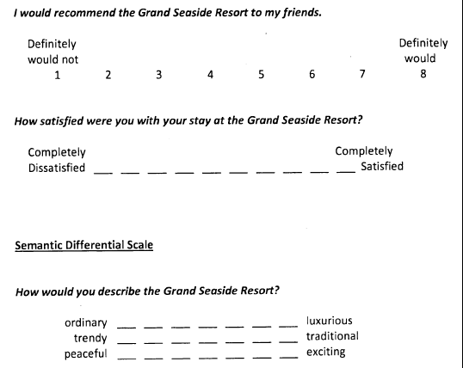
iClicker poll: what is the level of measurement for each response?
Hint: the most common scale on survey to measure the un-seen

